Slide 1
Basic Programming Concepts with Java and JavaScript and Unit Testing
Part 1

Slide 2
Table of Contents
Basic Programming Concepts 101
Similarities Between Java and JavaScript
Hello World in many ways…
Command Line Arguments Capture

Slide 3
Basic Programming Concepts 101
Introduction
Variables
Control Structure aka Control Flow
Data Structure

Slide 4
Introduction
Instructions
Variables
Operators
Destructive Assignment Concepts

Slide 5
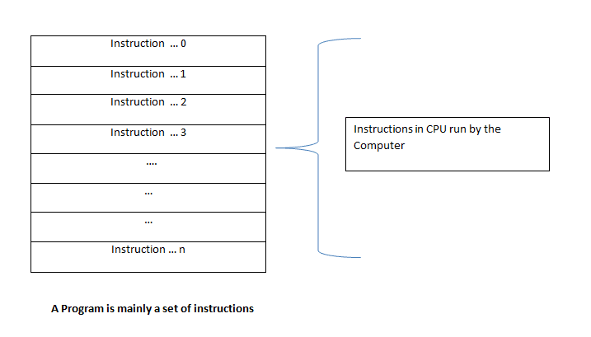
Introduction - Instructions
A Program is a set of instructions that a computer executes
Instructions are provided using concepts of statement
A statement is a line of code
Statement can be used to assign values to variables, execute logic, control flow, blocks of code, functions, etc.
A Central Processing Unit (CPU) and Memory (RAM) are required for a program to execute
Data is stored in memory

Slide 6
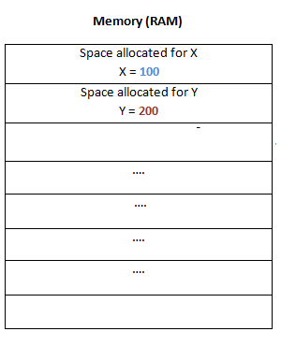
Introduction - Variables
Variable are initialized as pointers in RAM and values are assigned to them using an assignment operator
Scenario
X = 100
Y = 200

Slide 7
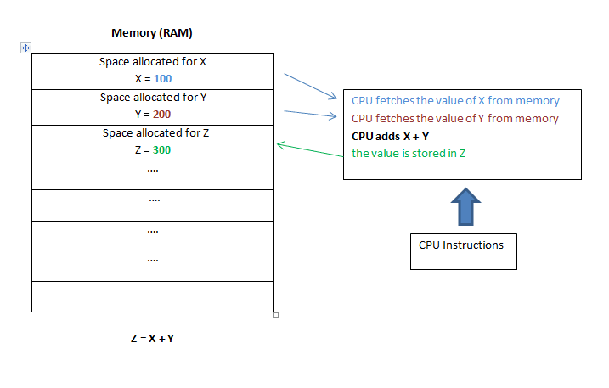
Introduction - Operators
Operators are used to perform math like functions in this case, adding the values of 2 variables and assigning the result to a new variable
Scenario
X = 100
Y = 200
Z
Z = X + Y

Slide 8
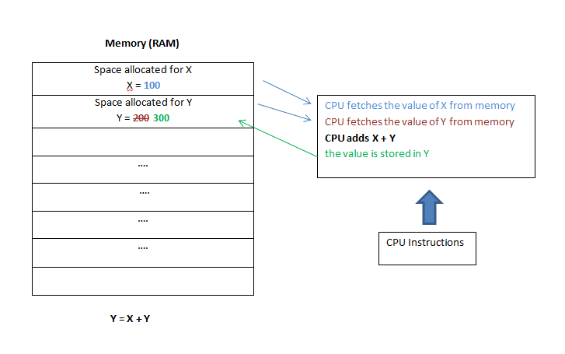
Introduction – Destructive Assignment Concept
The content of a variable can be overridden by reassigning a new value
Scenario
X = 100
Y = 200
Y = X + Y
Result: Y = 300

Slide 9
Variables
Definition: Variables are used to store information to be referenced and manipulated in a computer program. They also provide a way of labeling data with a descriptive name, so our programs can be understood more clearly by the reader and ourselves. It is helpful to think of variables as containers that hold information. Their sole purpose is to label and store data in memory. This data can then be used throughout your program.
Java | JavaScript
Strongly Typed Language Definition: A strongly-typed programming language is one in which each type of data (such as integer, character, hexadecimal, packed decimal, and so forth) is predefined as part of the programming language and all constants or variables defined for a given program must be described with one of the data types. int a = 10; Links: https://www.w3schools.com/java/java_variables.asp https://www.w3schools.com/java/java_data_types.asp | Weakly Type Language Definition: A weakly-typed programming language is one in which each type of data is assigned to a variable that doesn’t require being predefined by a data type such as integer, character, hexadecimal, packed decimal, and so forth) and during a destructive assignment new data assigned doesn’t have to be in the same data type as what is being replaced. var a = 10; Links https://www.w3schools.com/js/js_variables.asp https://www.w3schools.com/js/js_datatypes.asp https://developer.mozilla.org/en-US/docs/Web/JavaScript/Data_structures

Slide 10
Control Structure aka Control Flow
Definition: A control structure is a syntactic form in a language to express flow of control. A sequence of statements is executed depending on whether or not the condition it true or false . This means the program chooses between two or more alternative paths.
Common to both Java and JavaScript
if
if else
if else if
while
do while
for
break
continue
ternary operator: (condition) ? true : false
Java: http://www.corejavaguru.com/java/basic/controlstatements
JavaScript: https://www.w3schools.com/js/js_if_else.asp

Slide 11
Data Structure
Definition: A data structure is a specialized format for organizing, processing, retrieving and storing data. While there are several basic and advanced structure types, any data structure is designed to arrange data to suit a specific purpose so that it can be accessed and worked with in appropriate ways.
In Java and JavaScript, data structure do differ in many ways, there is however some commonalities with Array data types in a loose manner.
Java | JavaScript
Links: https://www.w3schools.com/java/java_arrays.asp | Links https://www.w3schools.com/js/js_arrays.asp

Slide 12
Basic Programming Concepts 101
Variables
Control Structure aka Control Flow
Data Structure

Slide 13
Similarities Between Java and JavaScript
Common Similarities are:
use { and } as code block delimiters
use ; to end statements
have a Math library e.g. Math.pow
have if, do...while (pretty much same syntax)
have return statements

Slide 14
Hello World in many ways…
JavaScript – Browser using a console’s debugger
JavaScript – Node JS
Java using Command Line Interface
Java using STS

Slide 15
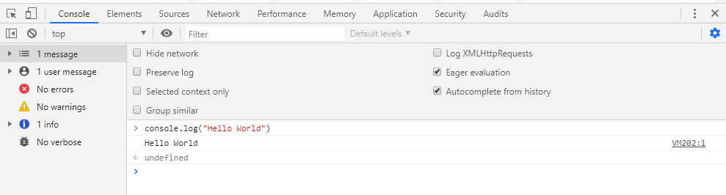
JavaScript – Browser using a console’s debugger
Using the Chrome debugger
Press F12
Ensure the ‘Console’ tab is selected
Type console.log(“Hello World”) and press ENTER
Should have a result as follows:

Slide 16
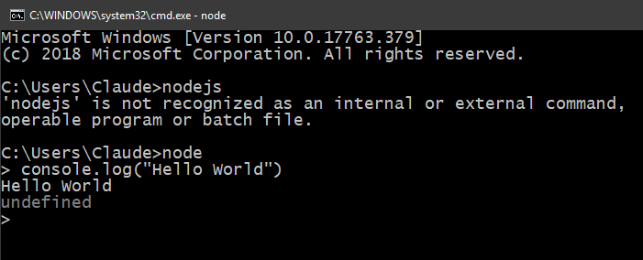
JavaScript – Node JS
Ensure NodeJS is installed
Using your Command Window (cmd) or your terminal
Type node and press Enter (or sudo node)
You should see a > cursor
Type console.log(“Hello World”) and press ENTER
Should have a result as follows:

Slide 17
Java using Command Line Interface (slide 1)
Ensure Java is installed
Create a folder on a root file system and name it “JumpJune2019”
Create a subfolder in JumpJune2019 and name it “helloworlds”
Create a subfolder name “cli”
We will be creating a Java app using Notepad++ or any simple text editor and we will be compiling and executing the application from the command line interface

Slide 18
Java using Command Line Interface (slide 2)
Type the following content
/*
This is a simple Java Program
Call this file HelloWorld.java
*/
public class HelloWorld {
public static void main(String[] args) {
// Prints "Hello, World" to the terminal window.
System.out.println("Hello, World");
}
}

Slide 19
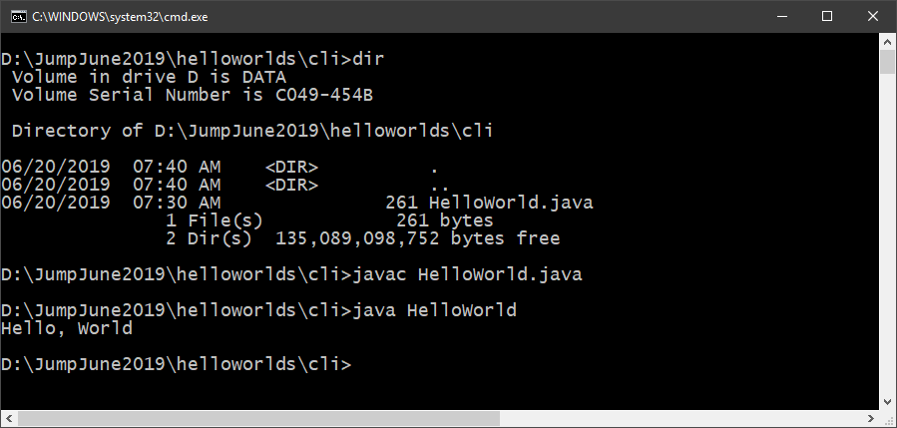
Java using Command Line Interface (slide 3)
Save the file with the name “HelloWorld.java” in folder \JumpJune2019\helloworlds\cli\
At the command prompt in the ..\cli\ directory type the following command
javac HelloWorld.java and press Enter
The result should be a HelloWorld.class
Run the app by typing
java HelloWorld and press Enter
Result should be same as the graphic to the right.

Slide 20
Java using STS (slide 1)
Ensure Java is installed
Create a folder on a root file system and name it “JumpJune2019”
Create a subfolder in JumpJune2019 and name it “helloworlds”
Create a subfolder name “sts”
We will be creating a Java app using the STS IDE and running the app within the IDEs environment

Slide 21
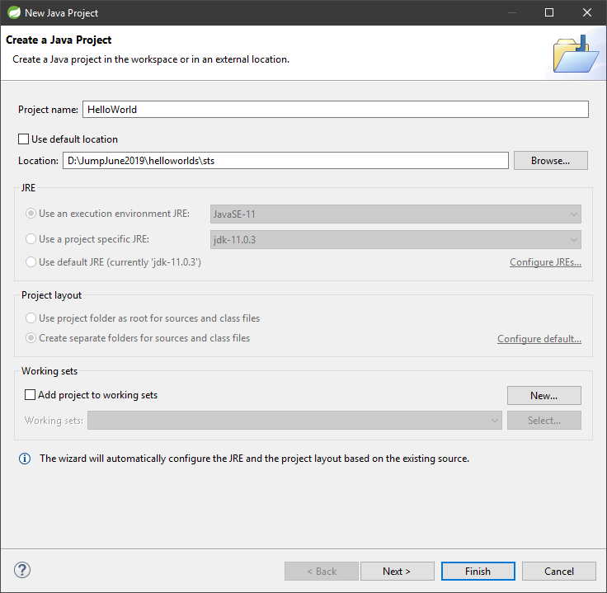
Java using STS (slide 1)
Open STS (no worries about workspace, use default)
Create a new Java Project
File… New… Java Project
In the New Java Project dialog box
Project Name: HelloWorld
Uncheck Use Default Location
Location: “your root drive”\JumpJune2019\helloworlds\sts
Click Finish

Slide 22
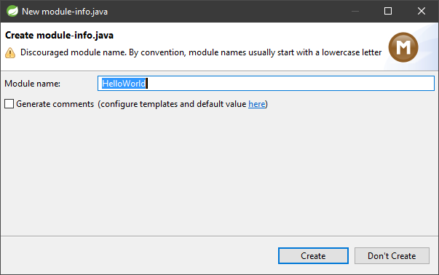
Java using STS (slide 2)
A dialog box titled New module-info.java will appear
It will provide you with a default module name “HelloWorld”, do not change it, click the “Create” button

Slide 23
Java using STS (slide 3)
A dialog box titled New module-info.java will appear
It will provide you with a default module name “HelloWorld”, do not create, click “Don’t Create”

Slide 24
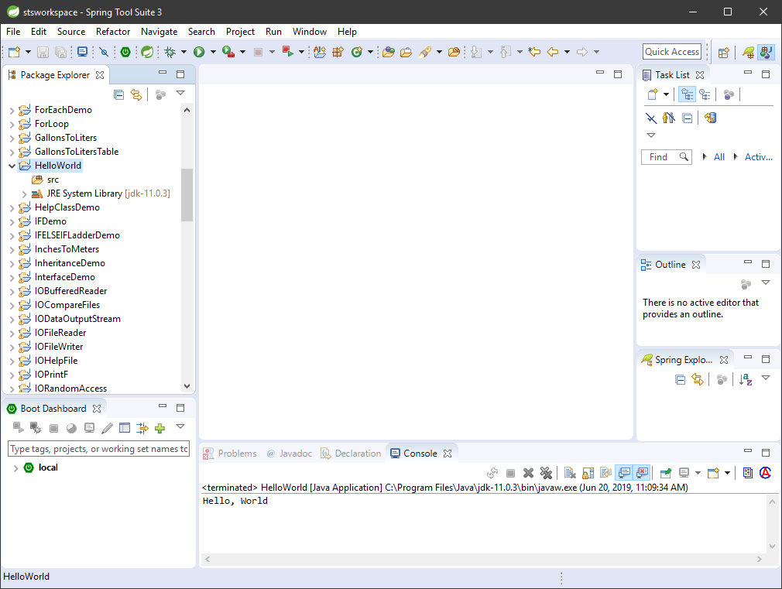
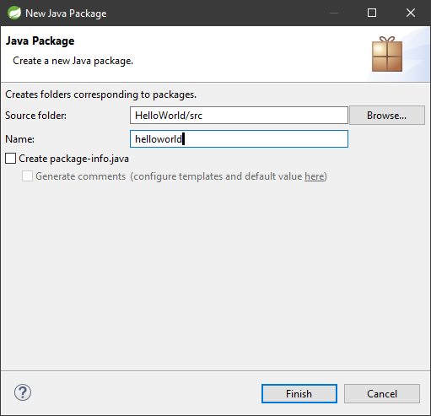
Java using STS (slide 4)
Create a package and name it “helloworld” in lower case
Right Click on ‘src’ folder
Select New.. Package..
Type “helloworld”
Click “Finish”

Slide 25
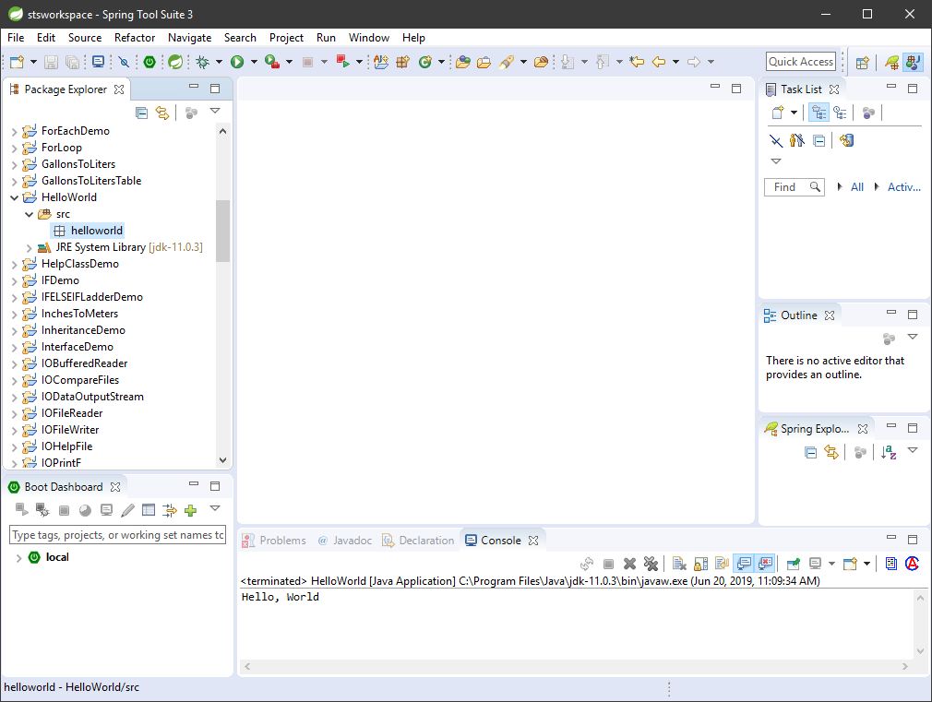
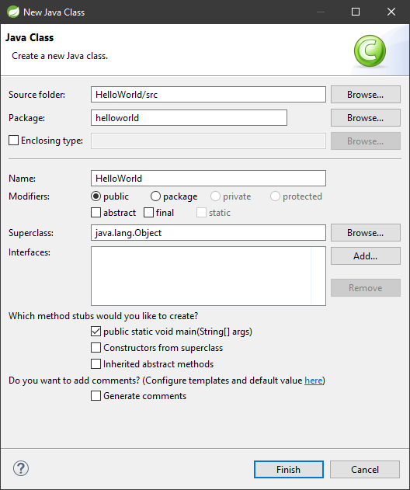
Java using STS (slide 5)
Create a class and name it “HelloWorld”
Right Click “helloworld” package and select New.. Class..
Name: HelloWorld
Ensure the selection matches the graphic and click “Finish”

Slide 26
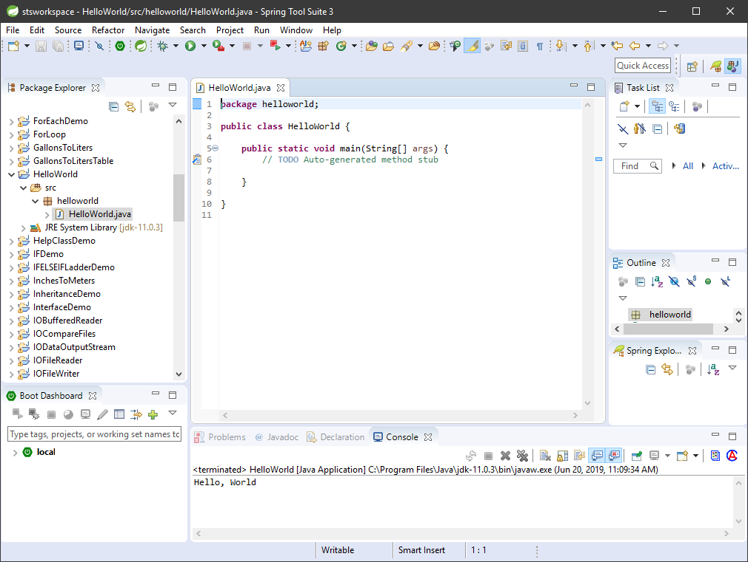
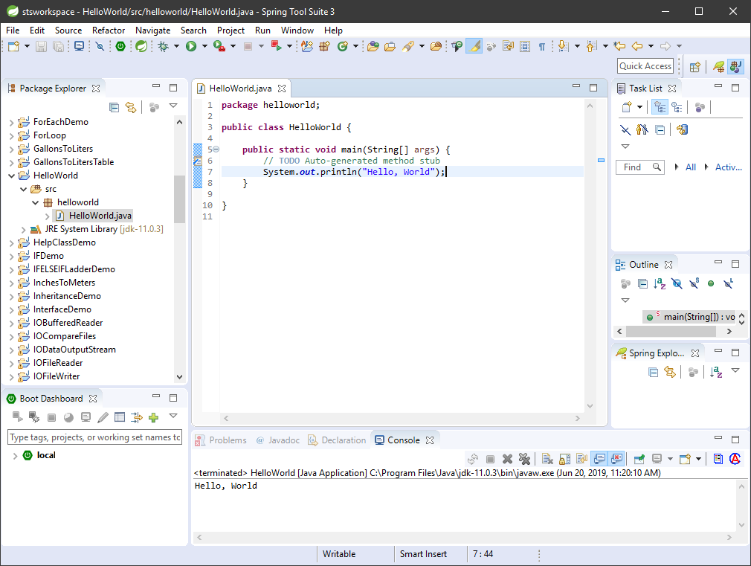
Java using STS (slide 6)
You will now add the statement as follows in the main function:
System.out.println("Hello, World");
Save the file
Click Run.
Select Run As
Select Java Application
Look at your console..

Slide 27
Command Line Arguments Capture
JavaScript (Node)
Java
Scenario
In both languages we will write an application which does the same thing.
The app will use arguments from the command line and determine if the first argument is a valid key and from there attempt to use the second argument

Slide 28
JavaScript (Node) (Slide 1)
Create a folder under “JumpJune2019” and name it “cli_arg_capture”.
Create a subfolder name “nodejs”
In your text editor you will add the following code.
Save the code as demo.js
// first arg is either an insult or a compliment
// second arg is the name of a person or thing
var myArgs = process.argv.slice(2);
console.log('myArgs: ', myArgs);
switch (myArgs[0]) {
case 'insult':
console.log(myArgs[1], 'smells quite badly.');
break;
case 'compliment':
console.log(myArgs[1], 'is really cool.');
break;
default:
console.log('Sorry, that is not something I know how to do.');
}

Slide 29
JavaScript (Node) (Slide 2)
At the command prompt “\JumpJune2019\cli_arg_capture\nodejs” you will be invoking the Demo.js application under various scenarios.
Scenario 1: >node Demo.js insult Bozo
Scenario 2: >node Demo.js compliment Flower
Scenario 3: >node Demo.js foo bar
Scenario 4) >node Demo.js foo
Scenario 5) >node Demo.js

Slide 30
Java (Slide 1)
/*
This is a simple Java Program
Call this file Demo.java
*/
// first arg is either an insult or a compliment
// second arg is the name of a person or thing
import java.util.Arrays;
public class Demo {
public static void main(String[] myArgs) {
try{
System.out.println(Arrays.toString(myArgs));
switch (myArgs[0]) {
case "insult":
System.out.println(myArgs[1] + " smells quite badly.");
break;
case "compliment":
System.out.println(myArgs[1] + " is really cool.");
break;
default:
System.out.println("Sorry, that is not something I know how to do.");
}
}
catch(ArrayIndexOutOfBoundsException e){
System.out.println("Sorry, that is not something I know how to do.");
}
}
}
Create a folder under “root/JumpJune2019/ cli_arg_capture” and name it “java”.
In your text editor you will add the following code.
Save the code as Demo.java
Compile the code
javac Demo.java

Slide 31
Java (Slide 2)
At the command prompt “\JumpJune2019\cli_arg_capture\cli” you will be invoking the Demo.js application under various scenarios.
Scenario 1: >java Demo insult Bozo
Scenario 2: >java Demo compliment Flower
Scenario 3: >java Demo foo bar
Scenario 4) >java Demo foo
Scenario 5) >java Demo

